Slide 1
How to register components?
(Generator)
You can see in: [hyperlink]
Focus 2
Contents Generation
Tutorial
Documents
and/or Videos
Also, you can see this video [“embedded movie” or hyperlink]
Support Contents
Database
Focus 1
Base information
Use Case Scenario of TossPedia
Usage of TossPedia
Q&A expected in user support situations about TossPedia (explain text)
What is XXXXX license?
Focus 3
Chatbot
Unfortunately, that license is not in our database..
Asking IP department is recommended if you need.
For your convenience, please send that license text or file in this dialogue
Screen Recorder
Video
Content Generator
Content Video
Foo bar foo…
Audio Generator
Audio
Thank you for your cooperation.
Please wait for the contact from IP.
Subtitle Generator
Subtitle

Slide 2
Content Generator
Content Video
Instructions
Support Contents Database
Base Information
Search Engine
Chatbot
Bot Core
Chatbot GUI

Slide 3
>

Slide 4

Component 2
(5)
Video
Content Generator
Video Link
(6)
Subtitle File
(7)
(9)
(8)
Support Contents Database
(4)
Component 1
Base Information
Component 3
(2)
Chatbot
(3)
(1)
User

Slide 5
Focus 2
Content Generator
(11)
Audio Generator
Audio
Video Generator
(10)
Content Video
Subtitle Generator
Subtitle
(12)
(9)
Timing
(8)
Screen Recorder
Video
(7)
Support Contents Database
Instructions
(13)
Instruction Generator
Focus 1
Base Information
(6)
Focus 3
Search Engine
(3)
(2)
(4)
Chatbot
Bot Core
(1)
(5)
Dev Team
Chatbox GUI
AI Team

Slide 6
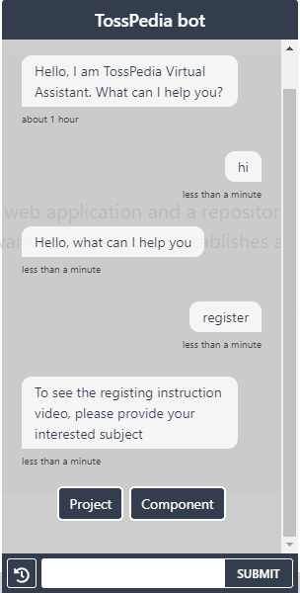
1
3
2
4
7
6
5

Slide 7

1

Slide 8
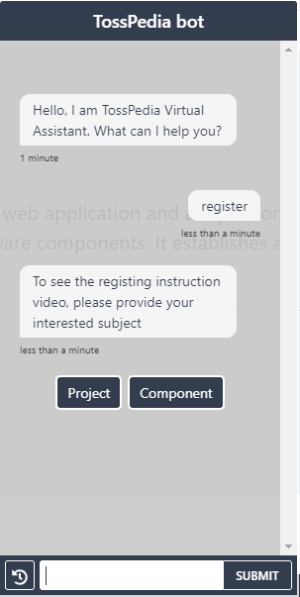
1
2
3
4
6
5
7

